Slide 1
Harmonization of Multiple Entries in the Terminology Database Struna (Croatian Special Field Terminology)
by Marina Bergovec, Siniša Runjaić
Institute of Croatian Language and Linguistics
Struna – Croatian Special Field Terminology
struna.ihjj.hr/en
Notes:
- Nakon njihovog uvoda, blagi prijelaz na činjenicu kako smo nas dvoje nakon kraćeg bavljenja disciplinom odlučili predstaviti ovaj rad kao dio svakodnevnih obaveza

Slide 2
Motivation
1. Going public
The Croatian language has travelled a long way to its complete independence and international acknowledgment
Terminology in Croatia is a young discipline, although its beginnings can be traced back to the 19th century
Struna – Development of Croatian Special Field Terminology, a process of terminology restandardization
Opening of the Struna search engine on February 21st, 2012 – data harmonization process was a necessity
Notes:
Prva natuknica: Hrvatska je priznata 1992, priznat i hrvatski jezik, ali dugo nakon toga (još 17 god) u različitim međunarodnim org (ISO, Library of Congress) nije imao svoj kod
Druga/treća natuknica: iz potpoglavlja “terminology work in Croatia” – iako su početci u 19st, tek se nedavno terminologijom počelo “ozbiljno” baviti
četvrta/peta natuknica: Pojasniti da nam je motivacija u prvom redu proizišla iz činjenice što smo iz statusa prve koliko-toliko “službene” nacionalne baze koja je bila “work in progress” (od 2008 do 2011) 21. 2. 2012. postali javno dostupna, i stoga se proces harmonizacije višestrukih koncepata i termina ispostavio kao nužda

Slide 3
Motivation
2. Traditional guidelines for terminological work
3.3. definition harmonization – activity leading to the description of a harmonized concept by an intensional definition that reflects the position of the concept in the harmonized concept system
3.4. term harmonization – activity leading to the selection of designations for a harmonized concept either in different languages or within the same language
[ISO 860:2007 Terminology work – Harmonization of concepts and terms. International Organization for standardization, Geneva (2007), p. 2]
Notes:
- Kao ne baš odviše iskusni, poprilično entuzijastični i s osjećajem odgovornosti prema korisnicima pokušali smo najširoj mogućoj bazi korisnika (od školaraca do stručnjaka i prevoditelja) urediti izlazne podatke u bazi čvrsto se držeći smjernica iz temeljnih terminoloških priručnika kao što je ISO 860 etc... – idealni je cilj bio jedan designat (izraz, naziv) za jedan koncept s jednoznačnim sadržajem definicije

Slide 4
Motivation
3. Complexity of the subject
Taxonomy is always a contentious issue because the world does not come to us in neat little packages.
[Gould, S.J. (1981). The mismeasure of man. New York : Norton, p. 158.]
Notes:
No, u procesu iščitavanja shvatli smo da stvari i nisu tako jednostavne ☺

Slide 5
Struna database
1. Foundations
Normative monolingual national terminology database in the Croatian language
Initiated by the Croatian Standard Language Council in 2007 which encouraged the launch of the Croatian Special Field Terminology (Struna) project
Financed by the National Foundation for Science, Higher Education and Technological Development of the Republic of Croatia
The National Foundation for Science, Higher Education and Technological Development holds a public competition once or twice a year (the selection of the domains according to the quality of individual proposals) and the need or requirements for the terminology of certain domains

Slide 6
Struna database
2. Main characteristics
Not a corpus-based terminological database
Ontological systems are not inherent
Field experts are expected to provide harmonized concepts, definitions, and designations
Linguistic and terminographical verification and technical support is provided by the Institute of Croatian Language and Linguistics
Final verification is also made by field experts
Notes:
Prva natuknica: polje kontekst postoji, ali nije prema (digitalnom) korpusnom uzorku već papirnom.
Druga natuknica: postoji polje s ontološki vezanim pojmovima/nazivima, ali nema inherentan ontološki sustav.
Treća natuknica: razlika od uobičajenog

Slide 7
Struna database
3. Disadvanatages
Field experts often do not understand or do not accept the concept of harmonized concepts
Field experts often fail to distinguish between the language for special purpose and general-purpose language
Each project worked independently of others - as a result the terminology of each subject field was analyzed and compiled separately

Slide 8
Struna database
4. Consequences
A considerable number of shared concepts
A relatively high percentage of multiple entries
A significant amount of discussion between field experts, terminologists and standard language specialists

Slide 9
Data harmonization process
1. Data analysis – theoretical background
Asumption 1: not all of the homographs will fall under the technical category „doublette“
Asumption 2: a certain number of homograph pairs or groups can be attributed to the principle of univocity, but a more representative number of multiple entries will include cases of synonymy
Aim: to present to subject field experts how doublettes can deteriorate the quality of a terminological database, and to offer the most acceptable model of terminographical description
Notes:
We expected mainly the terms with already defined superordinate concepts and their preferred term (type of, part of, consists of, etc.) to appear in this group.
We presumed that gerunds and other nouns with their superordinate concepts like process, property, action, device, etc. will appear in this group

Slide 10
Data harmonization process
2. Data analysis – working phases
1st phase: end of 2011 – a sample of 19384 terms from the termbase, of which 1920 (9.9 %) were terms requiring further analysis and harmonization (860 multiple entries = 673 doublettes + 187 that appeared in the termbase more than twice)
2nd phase: during January 2012 – 325 multiple entries were normalized and removed from the initial list in collaboration with field experts
3rd phase: a sample of 545 multiple entries still visible online in the search engine of the termbase before the “opening day” February 21st, 2012
Aim: to distinguish, by the comparison of concepts and terms, whether the still remaining multiple entries belong to the categories of homonymy or synonymy

Slide 11
Data harmonization process
3. Data analysis – initial statistics

Slide 12
Homonymy
The following cases were classified as homonyms:
Where a preferred term A and a preferred term B (or more) within a single project or shared between different projects correspond to different concepts, or a preferred term A and a preferred term B (or more) correspond to similar concepts, with specific meanings within the framework of a particular subject field (domain), but different enough to justify their existence as separate entries in the termbase.

Slide 13
Search engine

Slide 14
Homonymy – example 1

Slide 15
Homonymy – example 1

Slide 16
Homonymy – example 1

Slide 17
Homonymy – example 2
weather
time

Slide 18
Homonymy – example 2

Slide 19
Homonymy – example 2

Slide 20
Synonymy
The following cases were classified as synonyms:
Where a preferred term A and a preferred term B (or more) correspond to similar concepts and their subject domains and specific meanings within the framework of a particular subject field (domain) are almost identical. In such cases, the working group, together with field/subject experts and other coordinating partners, proposed one of the following two methods

Slide 21
Synonymy
Two methods:
Method A – If, from a terminographical point of view, one of the entries encompasses the concept in a more satisfactory way than the other(s), the working group proposes that only that entry remain visible to the public, and
Method B – If, from a terminographical point of view, none of the entries encompasses the concept in a satisfactory manner, the working group takes all data from given entries into account and harmonizes the definition in order to consolidate them into a single entry in the termbase.

Slide 22
Synonymy
Initial statistics

Slide 23
Synonymy method A – example

Slide 24
Synonymy method A – example
Term included in the search engine

Slide 25
Synonymy method A – example
Term excluded from the search engine

Slide 26
Synonymy method A – example

Slide 27
Synonymy method B – example

Slide 28
Synonymy method B example
no related concept
electrolitical cell
type of reaction
electrical potential

Slide 29
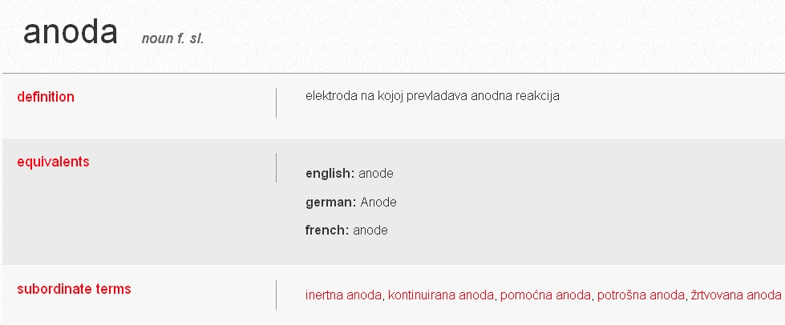
normalized definition + system of suboordinate terms
anoda – elektroda u elektrolitičkome procesu
na kojoj se odvija elektrodna reakcija oksidacije (differentia specifica)
replace

Slide 30
Synonymy method B example - antonym
no related concept
electrolitical cell
type of reaction
electrical potential

Slide 31
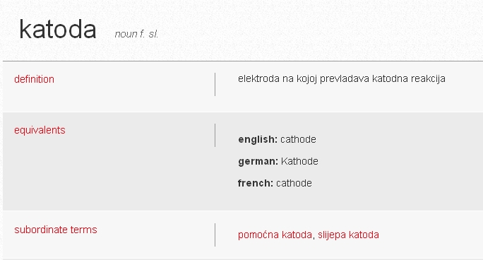
normalized definition + system of suboordinate terms
katoda – elektroda u elektrolitičkome procesu
na kojoj se odvija elektrodna reakcija redukcije (differentia specifica)
replace

Slide 32
Conclusion
80 percent of multiple entries turned out to be conceptual synonyms
data harmonization which begins at term level is time-consuming, rather demanding and potentially unsuccessful (in the case that field experts do not approve of the terminologists' proposals)
considering both the organizational structure and workflow of Struna, ongoing projects sketch concept systems and compile preliminary glossaries and present them to their assigned terminologists before entering the intended number of terms
This allows harmonization to begin at concept level and continue at term level, thereby considerably easing the harmonization process and improving the quality of the termbase

Slide 33
Thank You!

